Slide 1
Digital Portfolio
STUDENT NAME: D.AASHIFA BANU
REGISTER NO AND NMID: D1AB61F6C77EE319E5A4317FE3750EB3
DEPARTMENT: BSC COMPUTER SCIENCE
COLLEGE: COLLEGE/ UNIVERSITYTIRUPPUR KUMARAN COLLEGE FOR WOMEN

Slide 2

PROJECT TITLE

Slide 3


AGENDA
Problem Statement
Project Overview
End Users
Tools and Technologies
Portfolio design and Layout
Features and Functionality
Results and Screenshots
Conclusion
Github Link
3/21/2024 Annual Review

Slide 4

PROBLEM STATEMENT
A web-based platform showcasing an individual's or team's projects, skills, and experiences gained from participating in hackathons, coding challenges, or other tech-related events. It typically includes project descriptions, links to GitHub repositories, and contact information, serving as a digital portfolio to demonstrate technical abilities and creativity to potential employers, collaborators, or clients.

Slide 5

PROJECT OVERVIEW
A high-level summary or description of a project's objectives, scope, features, and functionalities, providing a concise understanding of what the project aims to achieve and what it entails. It typically includes key details such as project goals, target audience, technical requirements, and expected outcomes, serving as a foundational document for stakeholders, developers, and team members to align on the project's vision and direction.

Slide 6

WHO ARE THE END USERS?
The individuals or groups who will ultimately interact with, use, or benefit from a product, service, or system, such as potential employers, collaborators, or clients visiting a hackathon portfolio website to learn about a developer's skills and projects. They are the target audience for whom the product or service is designed. End users' needs, preferences, and behaviors are crucial in shaping the development and improvement of the product. They may provide valuable feedback to enhance user experience. Understanding end users helps ensure the product meets their expectations and solves their problems.

Slide 7

TOOLS AND TECHNIQUES
The software, methodologies, and practices used to design, develop, test, and deliver a project or product, such as programming languages, frameworks, libraries, and development tools. These tools and techniques enable developers to efficiently build, debug, and optimize their solutions. They may include version control systems, agile methodologies, and testing frameworks. The choice of tools and techniques can significantly impact the project's success, scalability, and maintainability. Effective use of tools and techniques can streamline development processes and improve productivity. Selecting the right tools is crucial for achieving project goals and deadlines.

Slide 8
POTFOLIO DESIGN AND LAYOUT
The visual arrangement and organization of content on a portfolio website or platform, including the selection of colors, typography, imagery, and overall aesthetic style. A well-designed portfolio layout effectively showcases projects, skills, and experiences, making it easy for visitors to navigate and understand the portfolio owner's capabilities. It typically includes sections for projects, about me, contact information, and sometimes blog or testimonials. The design should be responsive, user-friendly, and optimized for various devices and screen sizes. A good portfolio design enhances credibility and makes a strong impression on potential employers or clients. Clear typography and intuitive navigation are key elements.
8

Slide 9
FEATURES AND FUNCTIONALITY
The specific characteristics and capabilities of a product, system, or website that enable it to perform its intended purpose and meet user needs. Features refer to the individual components or elements, such as buttons, forms, or project showcases, while functionality refers to how these features work together to provide a seamless user experience. In a portfolio website, features might include project filtering, animations, or contact forms, while functionality would encompass how these features interact with users and deliver the desired outcome. Effective features and functionality are crucial for engaging users, conveying information, and achieving the website's goals. They should be intuitive, responsive, and optimized for usability.

Slide 10
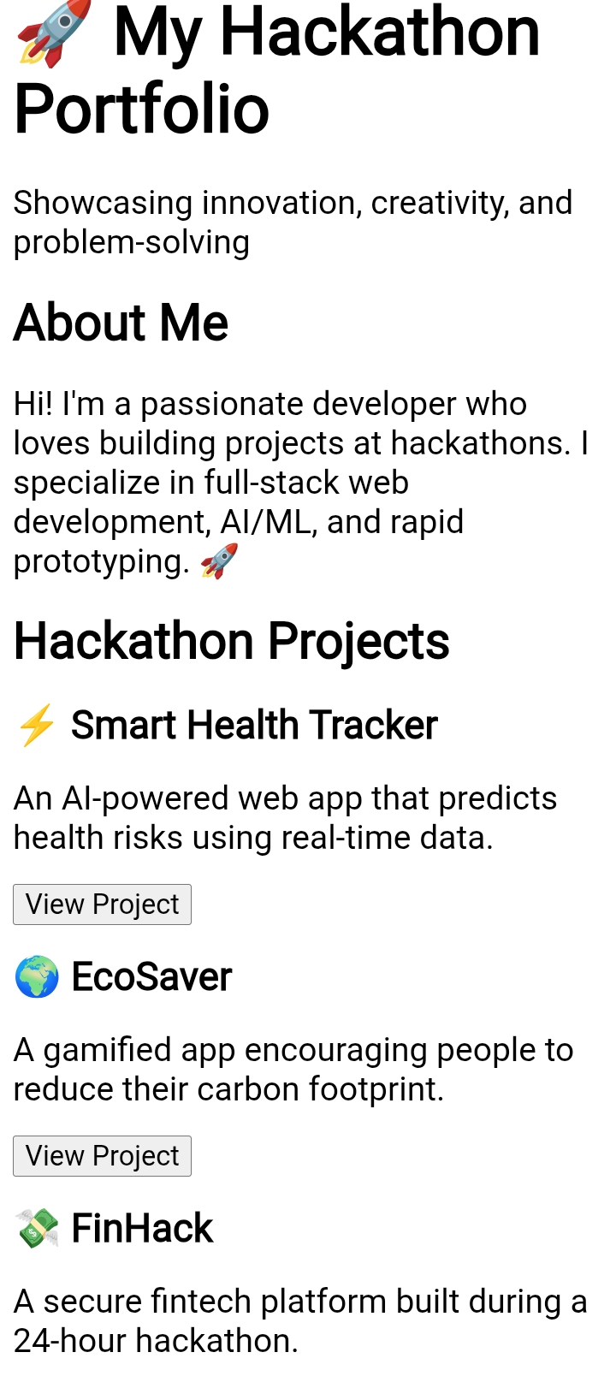
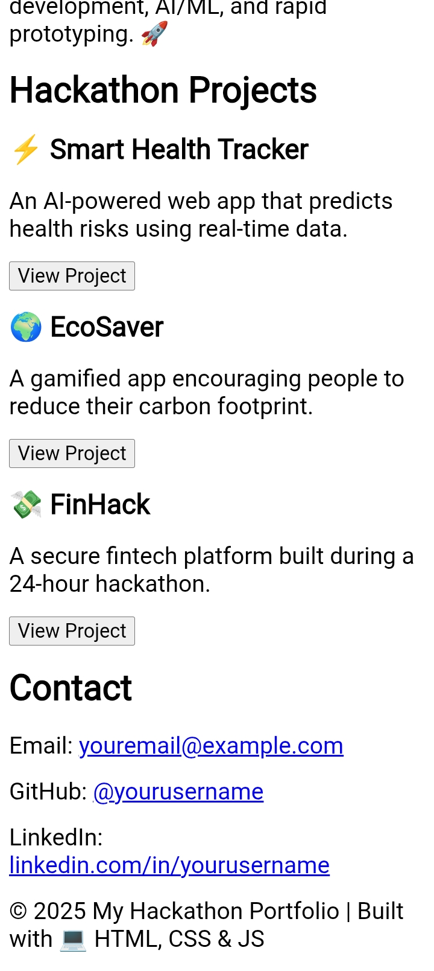

RESULTS AND SCREENSHOTS
3/21/2024 Annual Review
10

Slide 11
CONCLUSION
A summary of the key points, outcomes, and takeaways from a project, highlighting its achievements, lessons learned, and potential future directions. It provides a final assessment of the project's success in meeting its objectives and delivering value to users or stakeholders. A conclusion often reflects on the project's impact, identifies areas for improvement, and may outline potential next steps or applications. It serves as a closing statement that reinforces the project's significance and leaves a lasting impression on the audience. A well-crafted conclusion effectively wraps up the narrative and leaves the viewer with a clear understanding of the project's accomplishments and value.
11

